Slide 1
Data Mining: Data
Lecture Notes for Chapter 2
Introduction to Data Mining
by
Tan, Steinbach, Kumar

Slide 2
What is Data?
Collection of data objects and their attributes
An attribute is a property or characteristic of an object
Examples: eye color of a person, temperature, etc.
Attribute is also known as variable, field, characteristic, or feature
A collection of attributes describe an object
Object is also known as record, point, case, sample, entity, or instance
Attributes
Objects

Slide 3
Attribute Values
Attribute values are numbers or symbols assigned to an attribute
Distinction between attributes and attribute values
Same attribute can be mapped to different attribute values
Example: height can be measured in feet or meters
Different attributes can be mapped to the same set of values
Example: Attribute values for ID and age are integers
But properties of attribute values can be different
ID has no limit but age has a maximum and minimum value

Slide 4
Measurement of Length
The way you measure an attribute is somewhat may not match the attributes properties.

Slide 5
Properties of Attribute Values
The type of an attribute depends on which of the following properties it possesses:
Distinctness: = ≠
Order: < >
Addition: + -
Multiplication: * /
Nominal attribute: distinctness
Ordinal attribute: distinctness & order
Interval attribute: distinctness, order & addition
Ratio attribute: all 4 properties

Slide 6
Types of Attributes
There are different types of attributes
Nominal
Examples:
Ordinal
Examples:
Interval
Examples:
Ratio
Examples:

Slide 7
Types of Attributes
There are different types of attributes
Nominal
Examples: ID numbers, eye color, zip codes
Ordinal
Examples: rankings (e.g., taste of potato chips on a scale from 1-10), grades, height in {tall, medium, short}
Interval
Examples: calendar dates, temperatures in Celsius or Fahrenheit.
Ratio
Examples: temperature in Kelvin, length, time, counts

Slide 8
Example
Dec 3, 2000 ≠ Dec 24, 2000
Dec 3, 2000 <(=earlier than) Dec 24, 2000
Dec 24,2000 – Dec 3, 2000 = 21 days
BUT: (Dec 24, 2000) / (Dec 3, 2000) = ???
-> Dates are interval attributes.

Slide 9
Attribute Type
Description
Examples
Operations
Nominal
The values of a nominal attribute are just different names, i.e., nominal attributes provide only enough information to distinguish one object from another. (=, ≠)
zip codes, employee ID numbers, eye color, sex: {male, female}
mode, entropy, contingency correlation, χ² test
Ordinal
The values of an ordinal attribute provide enough information to order objects. (<, >)
hardness of minerals, {good, better, best}, grades, street numbers
median, percentiles, rank correlation, run tests, sign tests
Interval
For interval attributes, the differences between values are meaningful, i.e., a unit of measurement exists. (+, - )
calendar dates, temperature in Celsius or Fahrenheit
mean, standard deviation, Pearson's correlation
Ratio
For ratio variables, both differences and ratios are meaningful. (*, /)
temperature in Kelvin, monetary quantities, counts, age, mass, length, electrical current
geometric mean, harmonic mean, percent variation

Slide 10
Attribute Level
Transformation
Comments
Nominal
Any permutation of values
If all employee ID numbers were reassigned, would it make any difference?
Ordinal
An order preserving change of values, i.e., new_value = f(old_value) where f is a monotonic function.
An attribute encompassing the notion of good, better best can be represented equally well by the values {1, 2, 3} or by { 0.5, 1, 10}.
Interval
new_value =a * old_value + b where a and b are constants
Thus, the Fahrenheit and Celsius temperature scales differ in terms of where their zero value is and the size of a unit (degree).
Ratio
new_value = a * old_value
Length can be measured in meters or feet.

Slide 11
Discrete and Continuous Attributes
Discrete Attribute
Has only a finite or countably infinite set of values
Examples: zip codes, counts, or the set of words in a collection of documents
Often represented as integer variables.
Note: binary attributes are a special case of discrete attributes
Continuous Attribute
Has real numbers as attribute values
Examples: temperature, height, or weight.
Practically, real values can only be measured and represented using a finite number of digits.
Continuous attributes are typically represented as floating-point variables.

Slide 12
Types of data sets
Record
Data Matrix
Document Data
Transaction Data
Graph
World Wide Web
Molecular Structures
Ordered
Spatial Data
Temporal Data
Sequential Data
Genetic Sequence Data

Slide 13
Record Data
Data that consists of a collection of records, each of which consists of a fixed set of attributes

Slide 14
Data Matrix
If data objects have the same fixed set of numeric attributes, then the data objects can be thought of as points in a multi-dimensional space, where each dimension represents a distinct attribute
Such data set can be represented by an m by n matrix, where there are m rows, one for each object, and n columns, one for each attribute

Slide 15
Document Data
Each document becomes a `term' vector,
each term is a component (attribute) of the vector,
the value of each component is the number of times the corresponding term occurs in the document.

Slide 16
Transaction Data
A special type of record data, where
each record (transaction) involves a set of items.
For example, consider a grocery store. The set of products purchased by a customer during one shopping trip constitute a transaction, while the individual products that were purchased are the items.

Slide 17
Graph Data
Examples: Generic graph, HTML Links, Benzene Molecule: C₆H₆

Slide 18
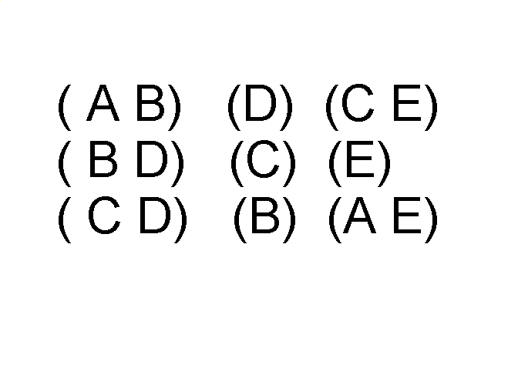
Ordered Data
Sequences of transactions
Items/Events
An element of the sequence

Slide 19
Ordered Data
Genomic sequence data

Slide 20
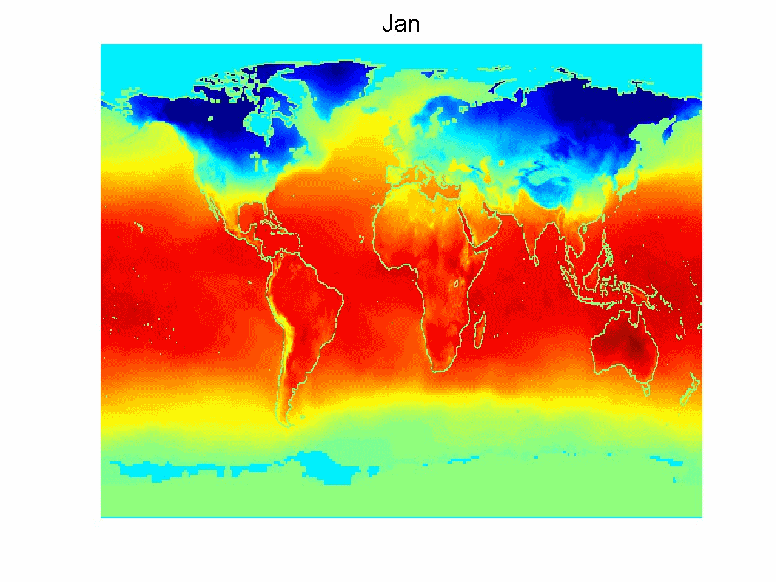
Ordered Data
Spatio-Temporal Data
Average Monthly Temperature of land and ocean

Slide 21
Data Quality
What kinds of data quality problems?
How to detect problems with the data?
What can we do about these problems?
Examples of data quality problems:
Noise, outliers, and inconsistencies
missing values
duplicate data

Slide 22
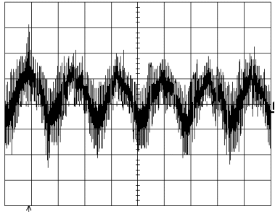
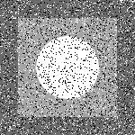
Noise
Noise refers to modification of original values
Examples: distortion of a person’s voice when talking on a poor phone and “snow” on television screen
Sine Wave + Noise
Image + Salt & Pepper Noise

Slide 23
Noise
Noise refers to modification of original values
Problem: Signal might be covered by noise
Sine Wave + Noise
Image + Salt & Pepper Noise

Slide 24

Outliers
Outliers are data objects with characteristics that are considerably different than most of the other data objects in the data set
Problem: many statistics (e.g. mean, min., max., etc.) are strongly affected by outlier

Slide 25
Data Inconsistencies
Single-source errors, e.g. repeated transactions, or communication errors
Data integration difficulties
Need not involve errors
Different representations (numeric precision)
Different scales or units
Conflicting meanings in different schema
Patient medications lists
Street address
How to resolve?
Select one of the conflicting values
Replace with estimated value

Slide 26
Merging data
Mapping data models
Translating forms
First, Middle, Last, Street, City, State, Zip, Telephone
Name, Address, Telephone
Translating values
56.1 to 56
56 to 56.00
Bill_Gates@MICROSOFT.com to bill_gates@microsoft.com
Logical versus procedural mappings
Describe relation vs prescribe steps

Slide 27
Which comes first?
Merging?
Preparation?

Slide 28
Merging data
Preparation for mapping
Error models
Missing city: NCSU vs UNC mailing lists
Smoothing models
Speed traps: Flaky™ vs WhizBang™ radar guns
Sampling methods
News & Observer vs Wall Street Journal

Slide 29
Merging issues
Conflict detection
Easy: data model indicates unique values
56 ≠ 56.1
Hard: conflicting derived attributes
Age = 5 & #children = 4
Conflict resolution
Preference order on data sets
Preference order on attributes
Probability model on values
Voting methods

Slide 30
Merge maintenance
(Almost) no one merges just once
Stability under remerges
Duplicates?
Errors?
Conflicts?

Slide 31
What is funny about all this?
Methods for perfecting data use data mining methods
To perfect data
To check perfection
Data mining methods use data perfected by data mining!
Should we worry about this?

Slide 32
Important Characteristics of Structured Data
Dimensionality
Curse of Dimensionality
Sparsity
Only presence counts
Resolution
Patterns depend on the scale

Slide 33
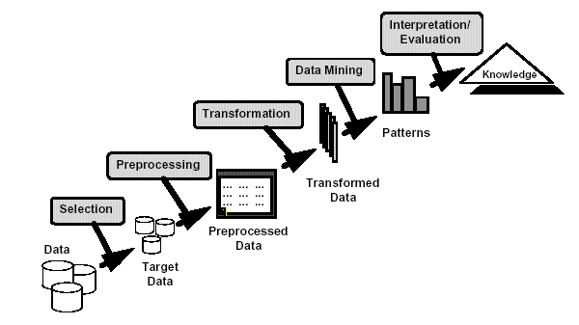
Data Preprocessing
Aggregation
Sampling
Dimensionality Reduction
Feature subset selection
Feature creation
Discretization and Binarization

Slide 34
Aggregation
Combining two or more attributes (or objects) into a single attribute (or object)
Purpose
Data reduction
Reduce the number of attributes or objects
Change of scale
Cities aggregated into regions, states, countries, etc
More “stable” data
Aggregated data tends to have less variability

Slide 35
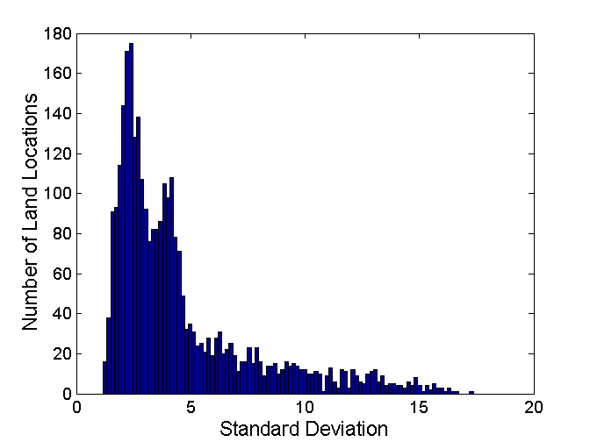
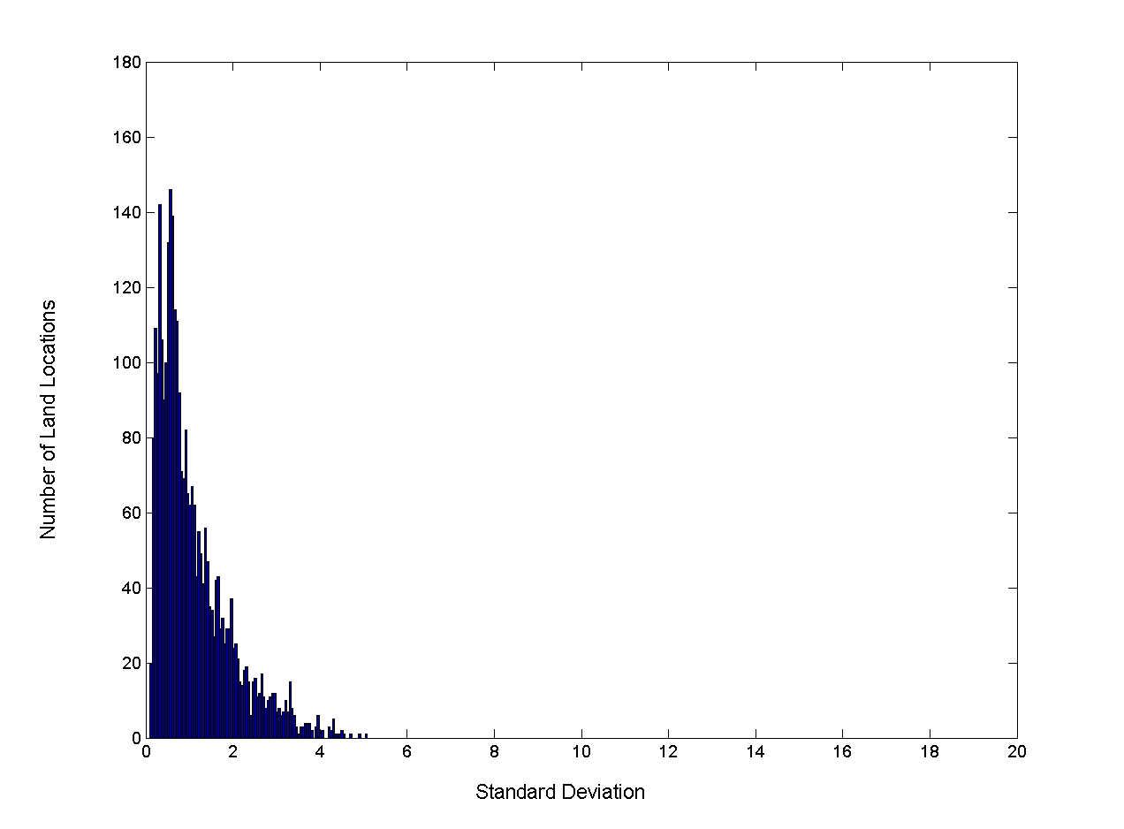
Aggregation
Variation of Precipitation in Australia
Standard Deviation of Average Monthly Precipitation
Standard Deviation of Average Yearly Precipitation

Slide 36
Aggregation using data cubes
OLAP (online analytical processing) often based on data cubes
A multidimensional data model akin to tables and spreadsheets
A sales data cube, for example, models data and allows viewing in multiple dimensions
Dimension tables, such as item (item_name, brand, type), or time(day, week, month, quarter, year)
Fact table contains measures (such as dollars_sold) and keys to each of the related dimension tables
Region
Product
Month

Slide 37
A sample data cube
Date
Total annual sales
of TV in U.S.A.
1Qtr
2Qtr
3Qtr
4Qtr
sum
Product
TV
PC
U.S.A
VCR
sum
Canada
Country
Mexico
sum
All, All, All

Slide 38
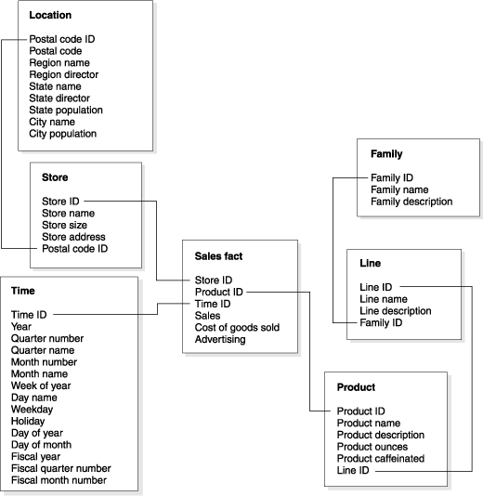
Fact Table and Dimension Tables

Slide 39
Typical OLAP operations
Roll up (drill-up): summarize data
by climbing up hierarchy or by dimension reduction
Drill down (roll down): reverse of roll-up
from higher level summary to lower level summary or detailed data, or introducing new dimensions
Slice and dice:
project and select
Pivot (rotate):
reorient the cube, visualization, 3D to series of 2D planes.
Other operations
drill across: involving (across) more than one fact table
drill through: through the bottom level of the cube to its back-end relational tables (using SQL)

Slide 40
Analysis-driven aggregation
Aggregate specific dimensions until desired size obtained
Different dimensions yield different sizes
Use the smallest size cube that leaves intact the dimensions one is trying to analyze

Slide 41
Sampling
Sampling is the main technique employed for data selection.
often used for both the preliminary investigation of the data and the final data analysis.
Statisticians sample because obtaining the entire set of data of interest is too expensive or time consuming.
Sampling is used in data mining because processing the entire set of data of interest is too expensive or time consuming.
Key principle for effective sampling:
a sample will work almost as well as using the entire data sets, if the sample is representative
A sample is representative if it has approximately the same property (of interest) as the original set of data

Slide 42

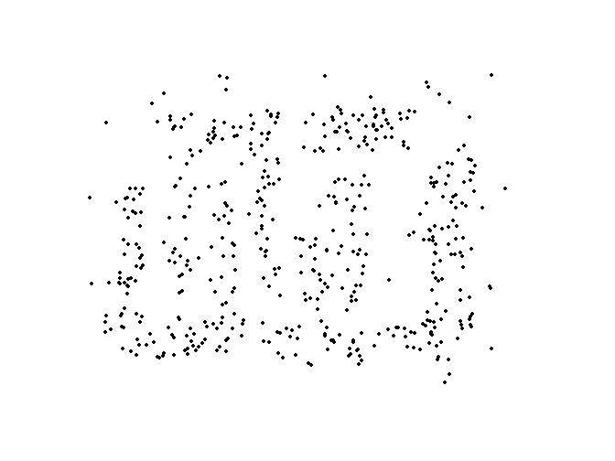
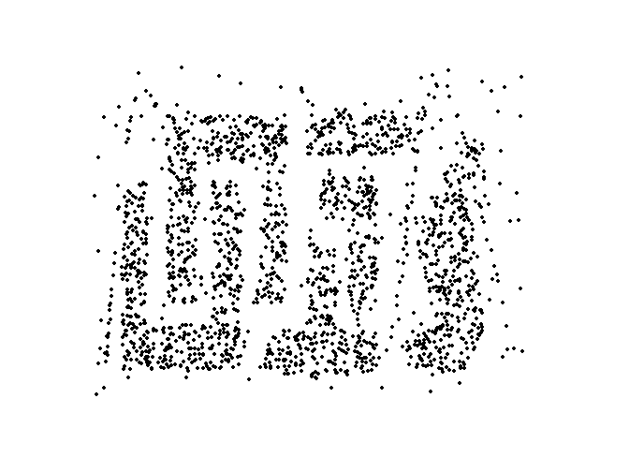
Sample Size
8000 points 2000 Points 500 Points

Slide 43
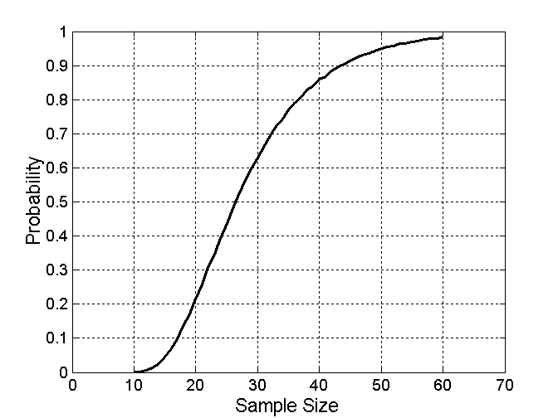

Sample Size
What sample size is necessary to get at least one object from each of 10 groups.

Slide 44
Types of Sampling
Simple Random Sampling
There is an equal probability of selecting any particular item
Sampling without replacement
As each item is selected, it is removed from the population
Sampling with replacement
Objects are not removed from the population as they are selected for the sample.
In sampling with replacement, the same object can be picked up more than once
Stratified sampling
Split the data into several partitions; then draw random samples from each partition

Slide 45
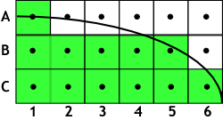
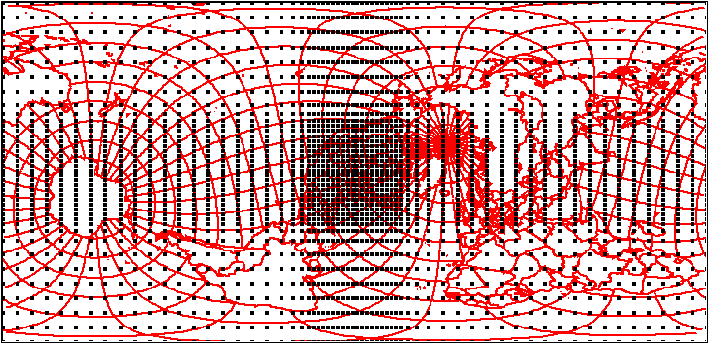
Grid-based Sampling
Fixed Grid:
Flexible Grid:

Slide 46
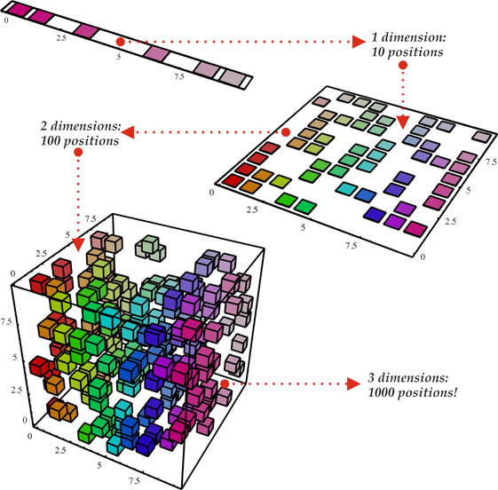
Curse of Dimensionality
When dimensionality increases, data becomes increasingly sparse in the space that it occupies
How many grid points do you need for a 10 dimensional cube?

Slide 47
Curse of Dimensionality
Example (Richard Bellman): 100 evenly-spaced sample points suffice to sample a unit interval with no more than 0.01 distance between points.
How many points with a spacing of 0.01 between adjacent points do you need for an equivalent sampling of a 10-dimensional unit hypercube?
Answer: 100¹⁰ = 10²⁰ that is a factor of 10¹⁸ more!

Slide 48
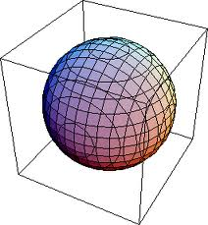
Curse of Dimensionality
When dimensionality increases, data becomes increasingly sparse in the space that it occupies

Slide 49
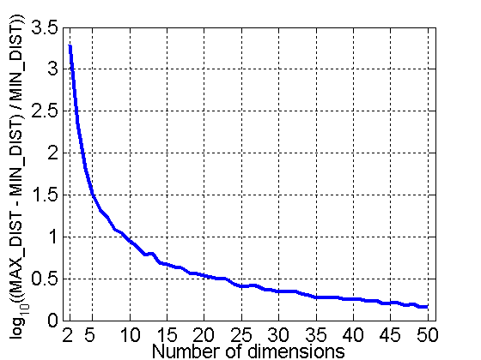
Curse of Dimensionality
When dimensionality increases, data becomes increasingly sparse in the space that it occupies
Definitions of density and distance between points, which is critical for clustering and outlier detection, become less meaningful
Randomly generate 500 points
Compute difference between max and min distance between any pair of points

Slide 50
Dimensionality Reduction
Purposes:
Avoid curse of dimensionality
Reduce amount of time and memory required by data mining algorithms
Allow data to be more easily visualized
May help to eliminate irrelevant features or reduce noise
Techniques
Principle Component Analysis (PCA)
Feature subset selection

Slide 51
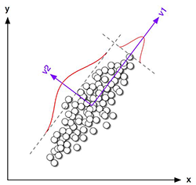
Dimensionality Reduction: Principle Componenent Analysis (PCA)
Goal is to find a projection that captures the largest amount of variation in data

Slide 52
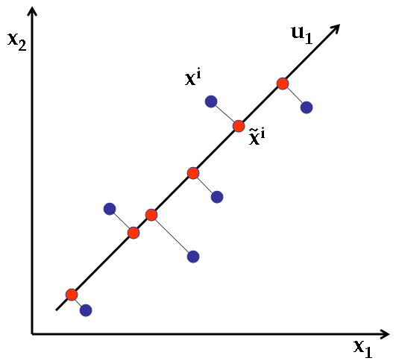
Dimensionality Reduction: Principle Componenent Analysis (PCA)
Goal is to find a projection that captures the largest amount of variation in data
v1

Slide 53

Dimensionality Reduction: PCA
Goal is to find a projection that captures the largest amount of variation in data

Slide 54
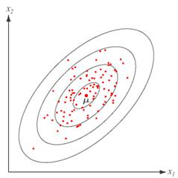
How PCA Works
Subtract mean (centering)
Find the eigenvectors of the covariance matrix
The eigenvectors are the principle components
PC1
PC2
= 0

Slide 55
Covariance of Two Vectors, cov(p,q)
Your text-book definition:
Mean of attributes
Better definition:
E is the Expected values of a random variable.

Slide 56
Covariance, or Dispersion Matrix,
N points in d-dimensional space:
The covariance, or dispersion matrix:
The inverse, Σ⁻¹, is concentration matrix or precision matrix

Slide 57
Mathematics behind PCA
Covariance matrix
Column means
Covariance matrix
Singular Value Decomposition (SVD)
Singular Value Decomposition (SVD)
The technique underlying PCA analysis
The technique underlying PCA analysis
Sum of k eigenvalues
=
Sum of k eigenvalues
Preserved variability
=
Eigenvectors/
Principal Components (orthonormal)
Preserved variability
Eigenvectors/
Principal Components (orthonormal)
Sum of all eigenvalues
Sum of all eigenvalues
PC1
PC1
PCk
PCk
with k dimensions
…
with k dimensions
…
Λ
Λ
U
U
U
U
T
∑
T
∑
d x d
d x d
Eigenvalues (diagonal matrix)
Eigenvalues (diagonal matrix)
Notes:
A lower-dimensional representation that contains the essence of the high dimensional data
Blessing of dependence that saves us from the curse of dimensionality
Principal Component Analysis is Spectral Decomposition of the Covariance Matrix
Linear dimension reduction:
Interpretable in original space
Preserves non-linearity for visualization
Orthogonal projections
Non-orthogonal projections
Favored for structure discovery
Non-linear dimension reduction:
Lower-dimensional representation
Interpretable w.r.t. Non-linear transformation
1 to 3 orders of magnitude more computation
Favored for prediction or classification

Slide 58
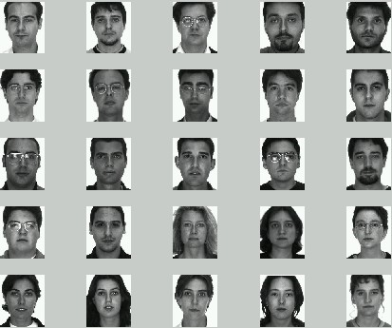
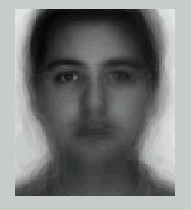
Eigenfaces
-
Transform images into a vector of size N and
build data matrix X.
Subtract average face

Slide 59
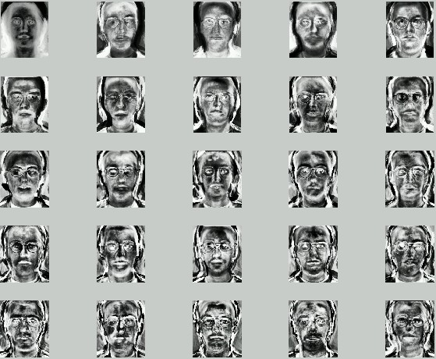
Eigenfaces (cont’d)
Project on first k principal components (dimensions)

Slide 60
Dimensionality Reduction: PCA

Slide 61
Feature Subset Selection
Another way to reduce dimensionality of data
Redundant features
duplicate much or all of the information contained in one or more other attributes
Example: purchase price of a product and the amount of sales tax paid
Irrelevant features
contain no information that is useful for the data mining task at hand
Example: students' ID is often irrelevant to the task of predicting students' GPA

Slide 62
Feature Subset Selection Techniques
Brute-force approach:
Try all possible feature subsets as input to data mining algorithm
Embedded approaches:
Feature selection occurs naturally as part of the data mining algorithm

Slide 63
Feature Subset Selection
Filter approaches:
Features are selected before data mining algorithm is run
Wrapper approaches:
Use the data mining algorithm as a black box to find best subset of attributes

Slide 64
Feature Creation
Create new attributes that can capture the important information in a data set much more efficiently than the original attributes
Three general methodologies:
Feature Extraction
domain-specific
Mapping Data to New Space
Feature Construction
combining features

Slide 65
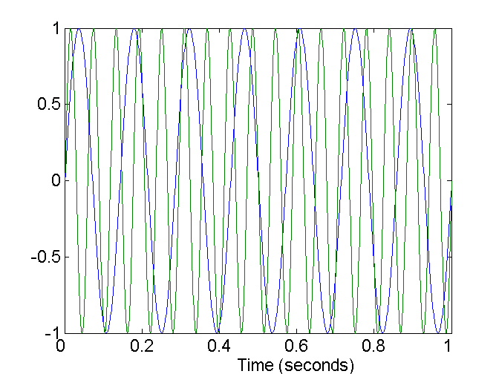
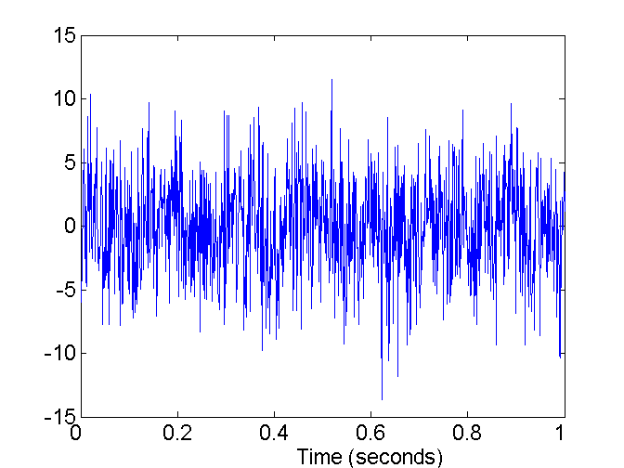
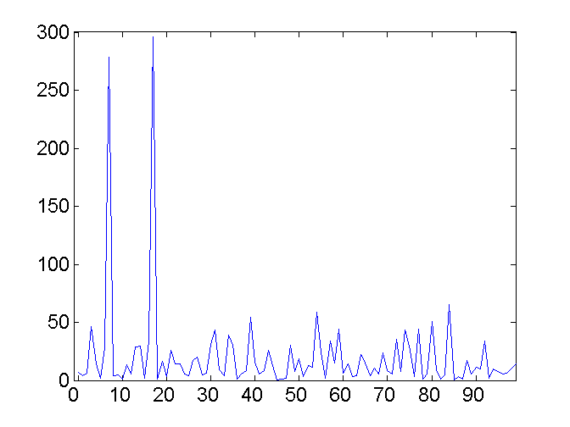
Mapping Data to a New Space
Fourier transform
Wavelet transform
Two Sine Waves
Two Sine Waves + Noise
Frequency

Slide 66
Wavelets
Fourier frequencies (basis vectors)
Wavelet frequencies (basis vectors)
Haar2
Daubechie4

Slide 67
Wavelet transforms
Approximate data by strongest elements of wavelet superposition series
Pad data length to 2^{n}
Apply to pairs of data to get half-size set
Transform performs both smoothing and difference
Apply recursively to get desired size
Akin to Fourier transform, but localized due to localized nature of basis vectors

Slide 68
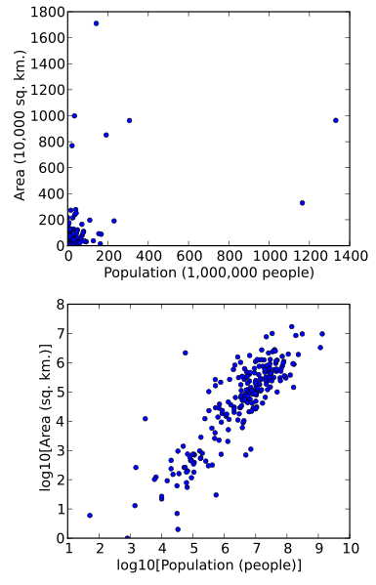
Attribute Transformation
A function that maps the entire set of values of a given attribute to a new set of values such that each old value can be identified with one of the new values
Simple functions: x^{k}, log(x), e^{x}, |x|
Standardization and Normalization
Scatterplot of areas and population of the states in the world. [WIKI]

Slide 69
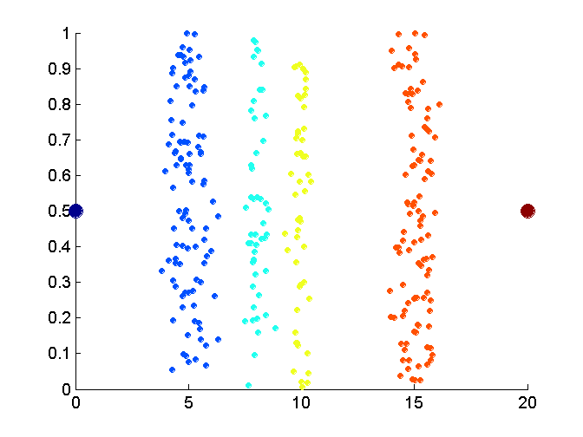
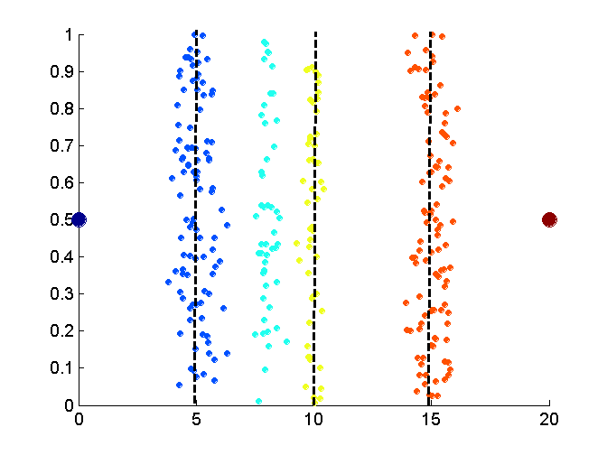
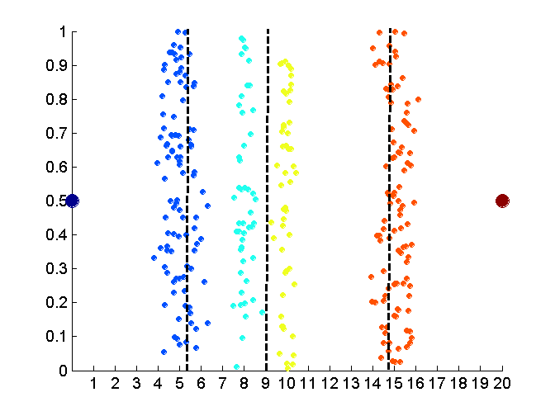
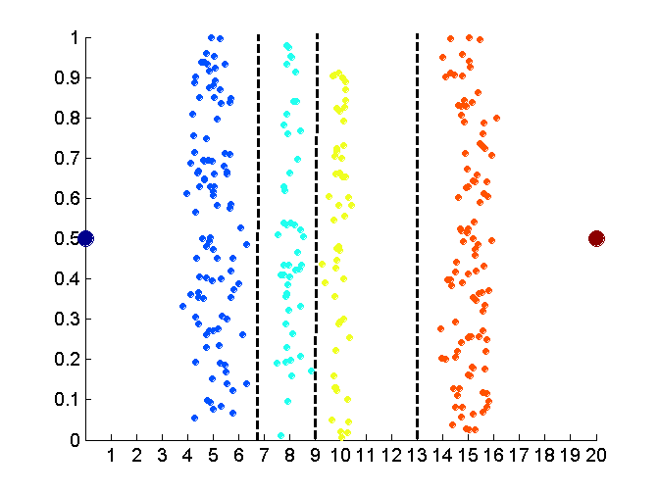
Discretization Without Using Class Labels
Data
Equal interval width
Equal frequency
K-means

Slide 70
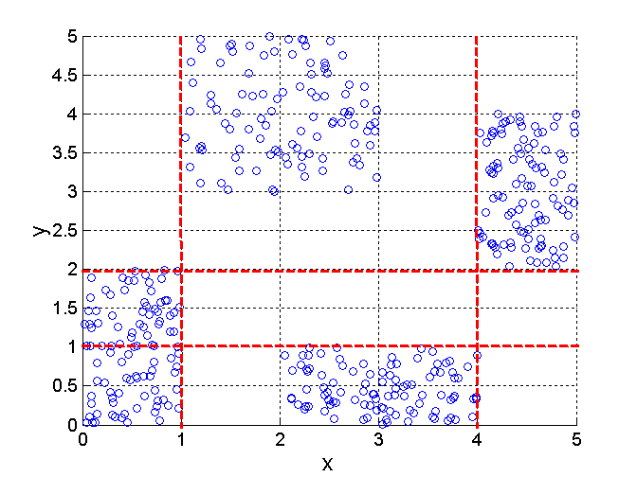
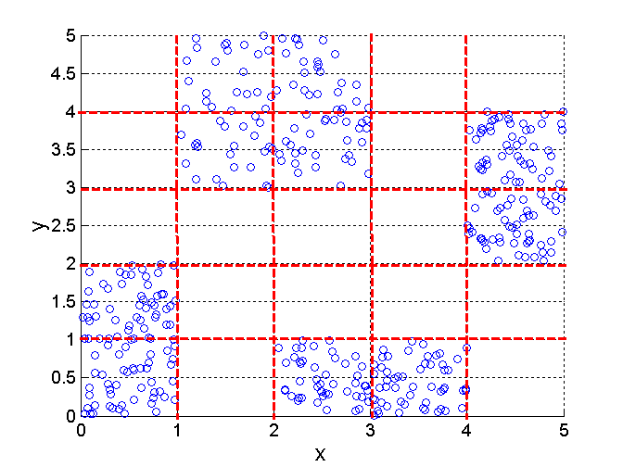
Discretization Using Class Labels
Entropy based approach
3 categories for both x and y
5 categories for both x and y

Slide 71
Bottom-up approach: Data → Methods
Data Question:
Lecture focus
Q1: What are the individual points?
Similarity/Dissimilarity/Distance Measure Question:
Q2: How to “compare” two points?

Slide 72
Similarity and Dissimilarity
Similarity
Numerical measure of how alike two data objects are.
Is higher when objects are more alike.
Often falls in the range [0,1]
Dissimilarity
Numerical measure of how different are two data objects
Lower when objects are more alike
Minimum dissimilarity is often 0
Upper limit varies
Proximity refers to a similarity or dissimilarity

Slide 73
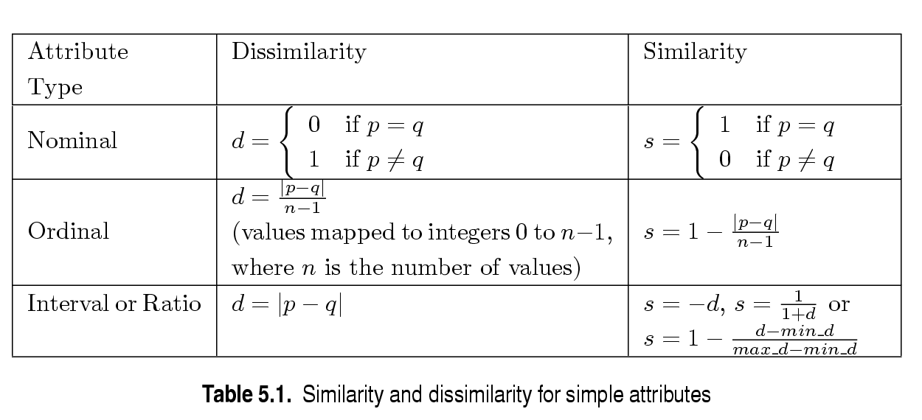
Similarity/Dissimilarity for Simple Attributes
p and q are the attribute values for two data objects.

Slide 74
Euclidean Distance
Standardization is necessary, if scales differ.
Ex:
Mean of attributes
Standard deviation of attributes
Standardized/Normalized Vector
Notes:
Give an example
What types of standardization

Slide 75
Minkowski Distance
Minkowski Distance is a generalization of Euclidean Distance
Where r is a parameter, n is the number of dimensions (attributes) and p_{k} and q_{k} are, respectively, the kth attributes (components) or data objects p and q.
unit circles with various values of r [Wikipedia]

Slide 76
Minkowski Distance: Examples
r = 1. City block (Manhattan, taxicab, L₁ norm) distance.
A common example of this is the Hamming distance, which is just the number of bits that are different between two binary vectors
r = 2. Euclidean distance
r → ∞. “supremum” (L_{max} norm, L∞ norm) distance.
This is the maximum difference between any component of the vectors
Do not confuse r with n, i.e., all these distances are defined for all numbers of dimensions.

Slide 77
Minkowski Distance
Distance Matrix

Slide 78
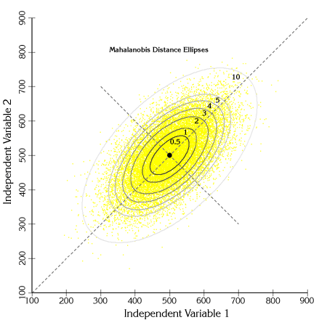
Mahalanobis Distance
Σ is the covariance matrix of the input data X

Slide 79
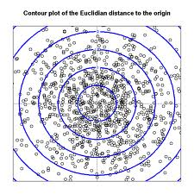
Mahalanobis Distance
Σ is the covariance matrix of the input data X

Slide 80
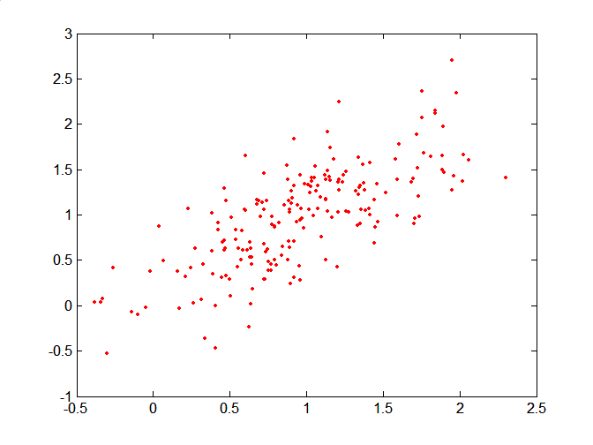
Mahalanobis Distance
Covariance Matrix:
C
B
A: (0.5, 0.5)
B: (0, 1)
C: (1.5, 1.5)
Mahal(A,B) = 5
Mahal(A,C) = 4
A

Slide 81
Common Properties of a Distance
Distances, such as the Euclidean distance, have some well known properties.
d(p, q) ≥ 0 for all p and q and d(p, q) = 0 only if p = q. (Positive definiteness)
d(p, q) = d(q, p) for all p and q. (Symmetry)
d(p, r) ≤ d(p, q) + d(q, r) for all points p, q, and r. (Triangle Inequality)
where d(p, q) is the distance (dissimilarity) between points (data objects), p and q.
A distance that satisfies these properties is a metric

Slide 82
Is this a metric?
Not: Positive definite
Not: Symmetric
Not: Triangle Inequality
Distance Metric

Slide 83
Common Properties of Similarity
Similarities also have some well known properties.
s(p, q) = 1 (or maximum similarity) only if p = q.
s(p, q) = s(q, p) for all p and q. (Symmetry)
where s(p, q) is the similarity between points (data objects), p and q.

Slide 84
Similarity Between Binary Vectors
Common situation is that objects, p and q, have only binary attributes
Compute similarities using the following quantities
M₀₁ = the number of attributes where p was 0 and q was 1
M₁₀ = the number of attributes where p was 1 and q was 0
M₀₀ = the number of attributes where p was 0 and q was 0
M₁₁ = the number of attributes where p was 1 and q was 1
Simple Matching and Jaccard Coefficients
SMC = number of matches / number of attributes
= (M₁₁ + M₀₀) / (M₀₁ + M₁₀ + M₁₁ + M₀₀)
J = number of 11 matches / number of not-both-zero attributes values
= (M₁₁) / (M₀₁ + M₁₀ + M₁₁)

Slide 85
SMC versus Jaccard: Example
p = 1 0 0 0 0 0 0 0 0 0
q = 0 0 0 0 0 0 1 0 0 1
M₀₁ = 2 (the number of attributes where p was 0 and q was 1)
M₁₀ = 1 (the number of attributes where p was 1 and q was 0)
M₀₀ = 7 (the number of attributes where p was 0 and q was 0)
M₁₁ = 0 (the number of attributes where p was 1 and q was 1)
SMC = (M₁₁ + M₀₀)/(M₀₁ + M₁₀ + M₁₁ + M₀₀) = (0+7) / (2+1+0+7) = 0.7
J = (M₁₁) / (M₀₁ + M₁₀ + M₁₁) = 0 / (2 + 1 + 0) = 0

Slide 86
Cosine Similarity
If d₁ and d₂ are two document vectors, then
cos( d₁, d₂ ) = (d₁ • d₂) / ||d₁|| ||d₂|| ,
where • indicates vector dot product and || d || is the length of vector d.
Example:
d₁ = 3 2 0 5 0 0 0 2 0 0
d₂ = 1 0 0 0 0 0 0 1 0 2
d₁ • d₂= 3*1 + 2*0 + 0*0 + 5*0 + 0*0 + 0*0 + 0*0 + 2*1 + 0*0 + 0*2 = 5
||d₁|| = (3*3+2*2+0*0+5*5+0*0+0*0+0*0+2*2+0*0+0*0)^{0.5} = (42) ^{0.5} = 6.481
||d₂|| = (1*1+0*0+0*0+0*0+0*0+0*0+0*0+1*1+0*0+2*2) ^{0.5} = (6) ^{0.5} = 2.245
cos( d₁, d₂ ) = .3150

Slide 87
Extended Jaccard Coefficient (Tanimoto)
Variation of Jaccard for continuous or count attributes
Reduces to Jaccard for binary attributes

Slide 88
Correlation
Correlation measures the linear relationship between objects
To compute correlation, we standardize data objects, p and q, and then take their dot product

Slide 89
Visually Evaluating Correlation
Scatter plots showing the similarity from –1 to 1.

Slide 90
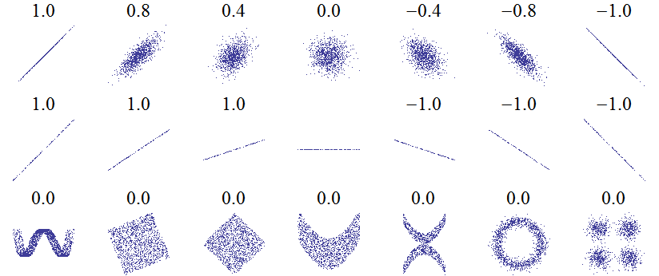
Warning!!! Correlation can be tricky
Scatter plots showing the similarity from –1 to 1.
Guess the correlation coefficient

Slide 91
General Approach for Combining Similarities
Sometimes attributes are of many different types, but an overall similarity is needed.

Slide 92
Using Weights to Combine Similarities
May not want to treat all attributes the same.
Use weights w_{k} which are between 0 and 1 and sum to 1.

Slide 93

Thank You!

